Slide 1

CiakTime
Human Computer Interaction Course Prof.ssa Catarci Prof.ssa Mirabella A.A. 2020/2021
Mauro Ficorella – 1941639 Martina Turbessi – 1944497 Valentina Sisti - 1952657

Slide 2
Idea
We are presenting CiakTime, an app designed for cinema lovers.
This app offers the following functionalities:
Search for movies by title and for members of the cast
Read information about plot, cast, year of release, duration, genre, movie director and streaming platform on which the movie is available
Look for popular and upcoming movies
Keep track of already watched movies
Add new movies in a watchlist to track the movie the user wants to watch
Add movies to “favourite movies” list
Review and rate watched movies
Comment and like reviews made by other users

Slide 3




Competitors analysis
IMDb
+500k downloads
Strengths:
Huge fanbase
Reference app regarding cinema and movies
Limitless cinema database
Offers information about showtimes and theatres
Suggests movies based on users’ watchlists
Weaknesses:
No exchange of opinions between users
No possibility to keep track of already watched movies
No possibility to save favourite movies in a list
It’s not very intuitive retrieve movies specific information due to the high number of functionality offered by the application

Slide 4


Competitors analysis
Cinemaniac
+500k downloads
Strengths:
Keep track of seen movies
Possibility to save favourite movies in a list
Statistics about user watch history and preferences
Weaknesses:
Interface not so user friendly
No user interaction
No information about streaming platform
Search about movies not intuitive
In-app purchases to remove advertisements and unlock some functionalities

Slide 5


 | CiakTime | IMDb | Cinemaniac
User profile
Search
Movie info
Streaming platform
Upcoming movies
Watch history
Watch list
Favourite movies
Review movies
Rate movies
Comment other reviews
Like other reviews
No ads

Slide 6



User profile
Age | 18-50 years
Gender
Profession | Any
Education | Any
Location | Any
Technology | Basic smartphone experience
Passions | Cinema, movies

Slide 7

Persona
Vittoria is 25 years-old and comes from Rome. She is a university student and in the free time her main hobby is watching movies and tv-series on her favourite streaming platforms.
During her study breaks she likes to keep in touch with her friends on various social apps.
Scenario
Vittoria has just terminated an intense study session and now she only wants to relax watching a movie. She decides to call her best friend to spend the evening together. Once she arrives, in order to choose which movie to watch, they both open the app to compare their watchlists. After a while they realize that both have “La La Land“ in their watchlists and so decide to watch it together.
At the end of the evening they both check it as “watched“ in their app.

Slide 8

Persona
Emanuele is 33 years-old and comes from Torino. He is a programmer and he likes very much going to the cinema with his girlfriend.
As a programmer, he is addicted of technology in general, and more specific of mobile devices; moreover he is a very organized guy, and so he likes to keep under control everything he does in his life using mobile apps.
Scenario
It is an afternoon autumn day. Emanuele and his girlfriend would have liked to go out for a walk, but since it’s raining, they don’t know what to do. So, Emanuele opens the app in search of new movies available in cinemas. In this list he founds that is just available a new action movie with his favourite actor Vin Diesel; since also his girlfriend likes action movies, they decide to go to the cinema to watch it and spend a good afternoon together.

Slide 9
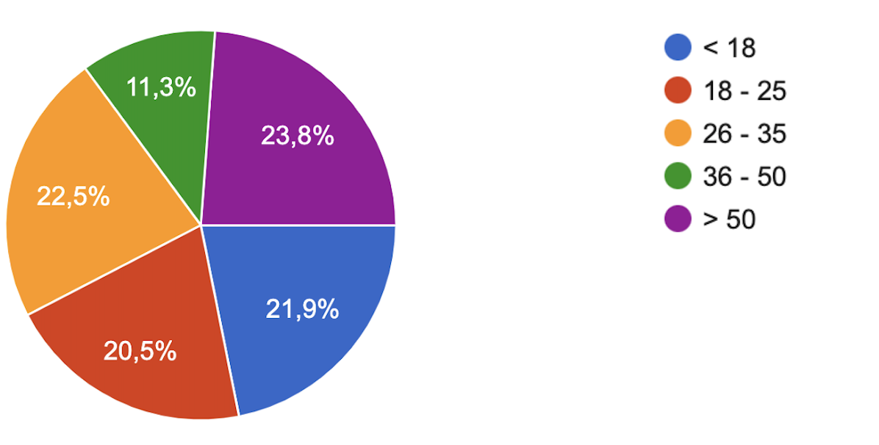
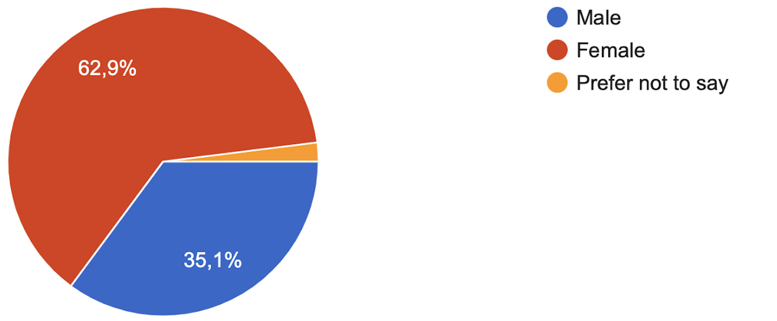
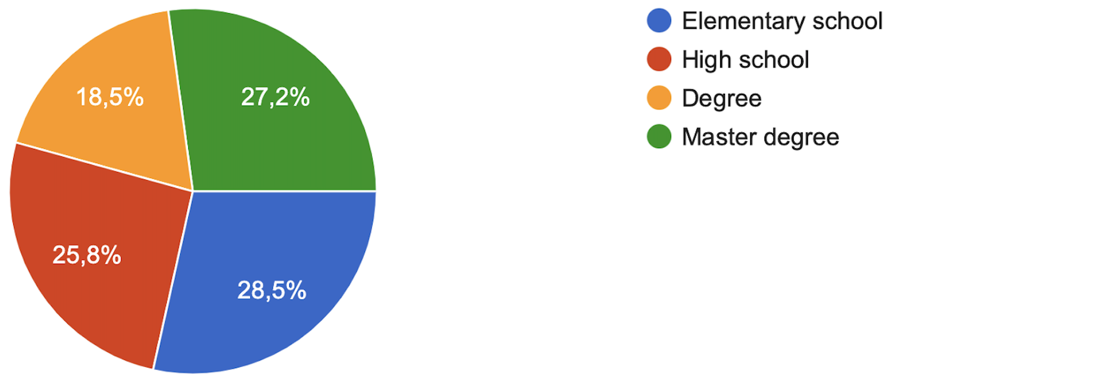
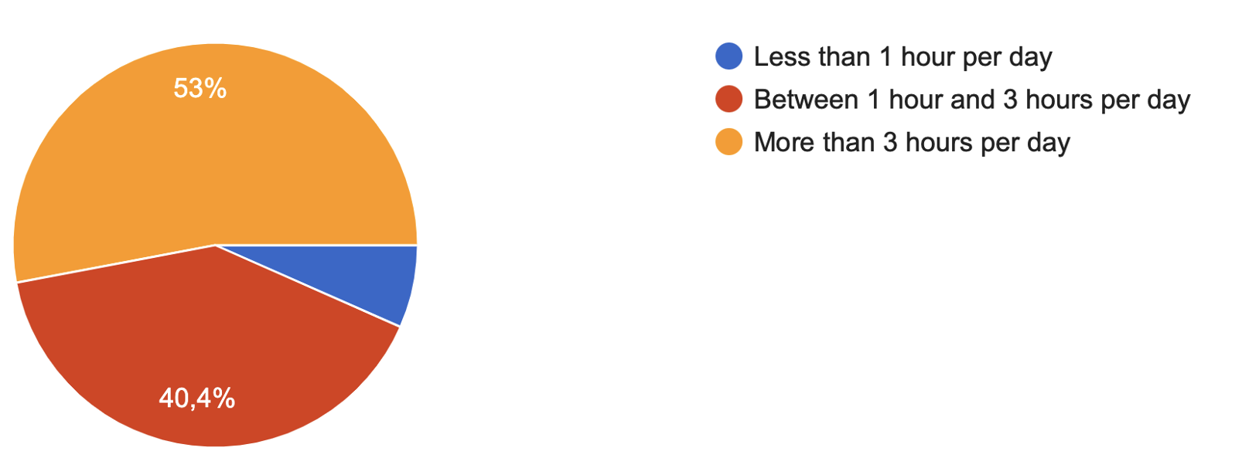
Questionnaire – Part 1
What's your age?
What's your gender?
What's your educational level?
How frequently do you use your smartphone on average?

Slide 10
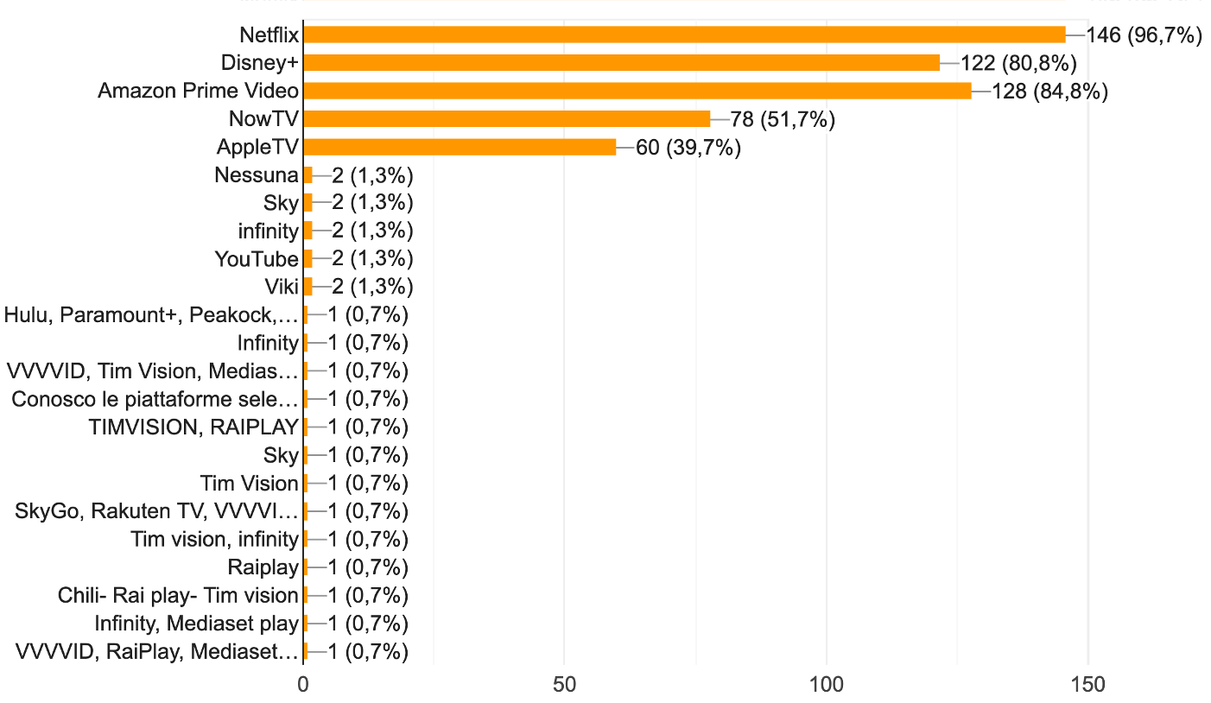
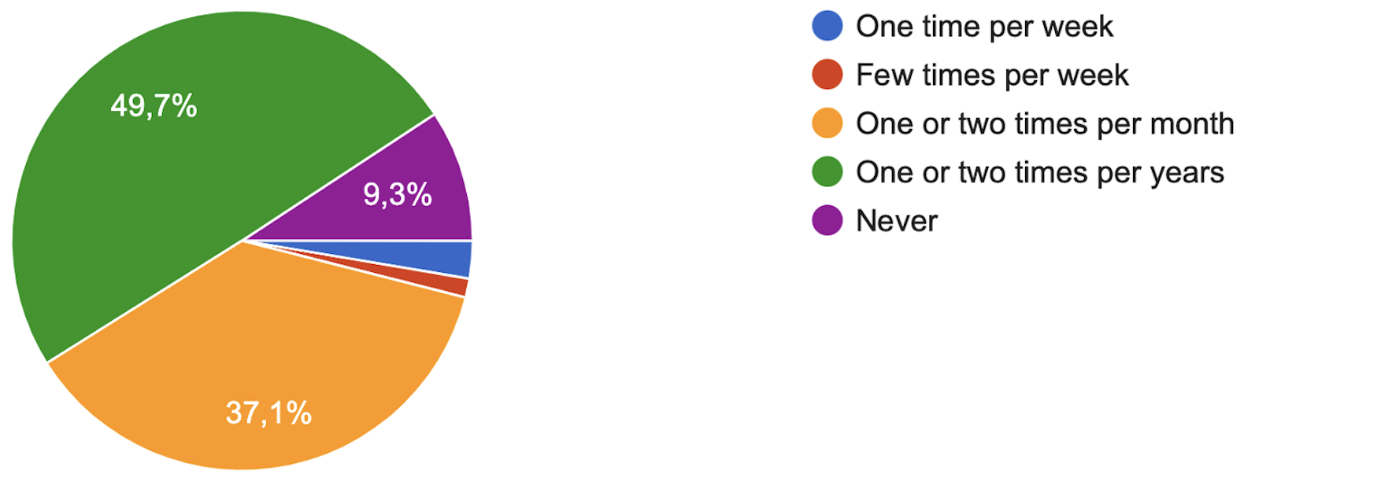
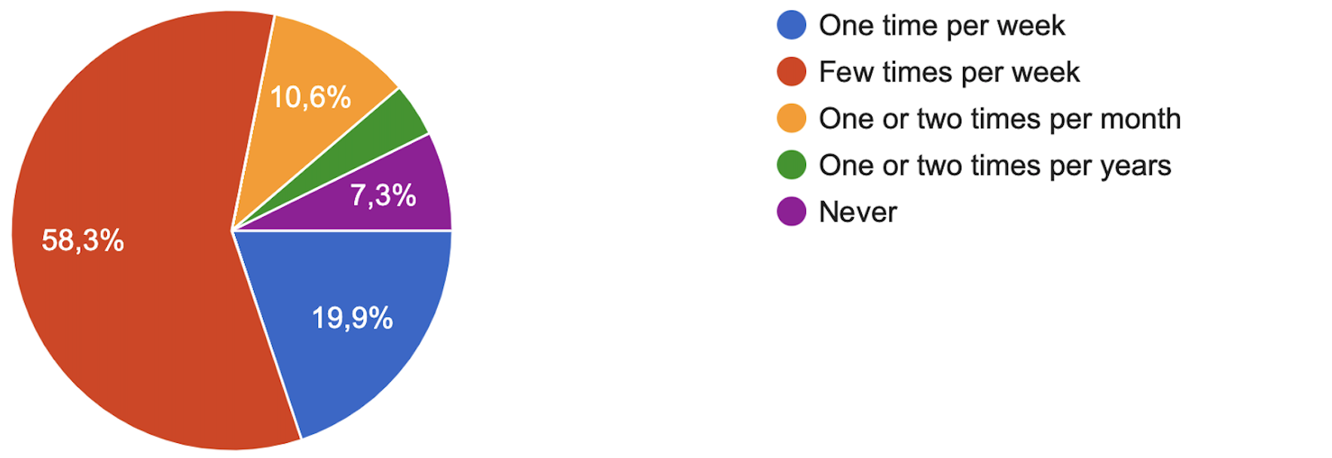
Questionnaire – Part 2
How many times do you go to the cinema on average? (Before pandemic)
Which streaming platforms do you know?
How many times do you watch movies on
streaming platforms/tv on average?

Slide 11
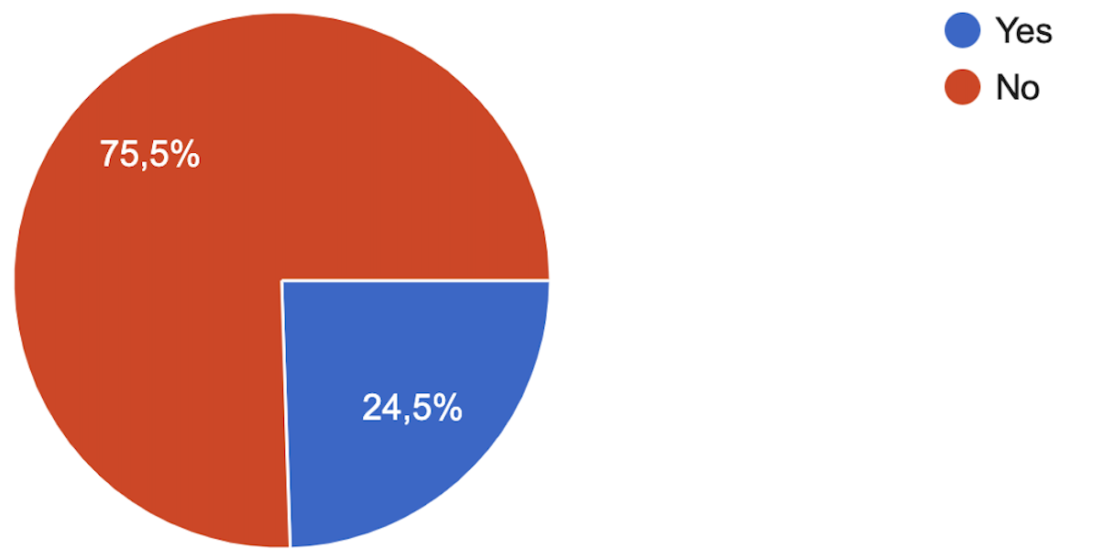
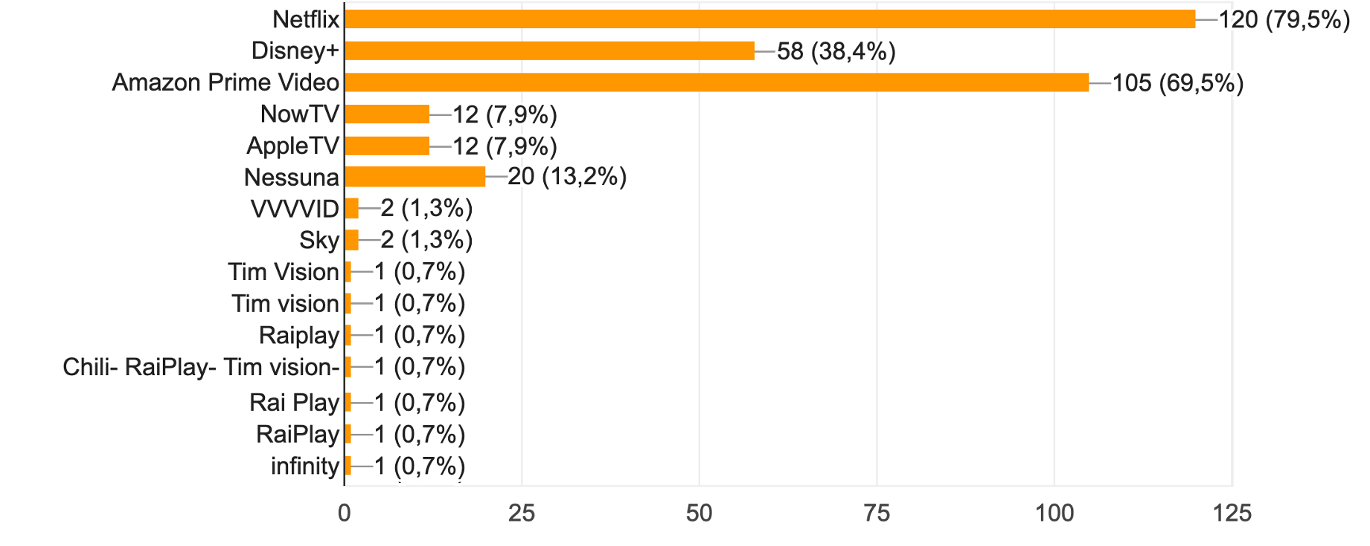
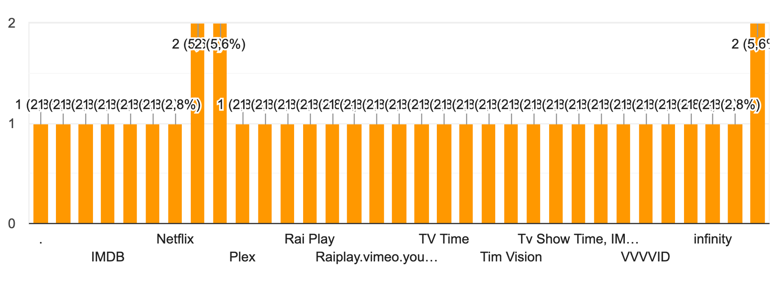
Questionnaire – Part 3
Do you use any movies related app?
Which streaming platforms do you use?
If you use any movies related app, which one?

Slide 12
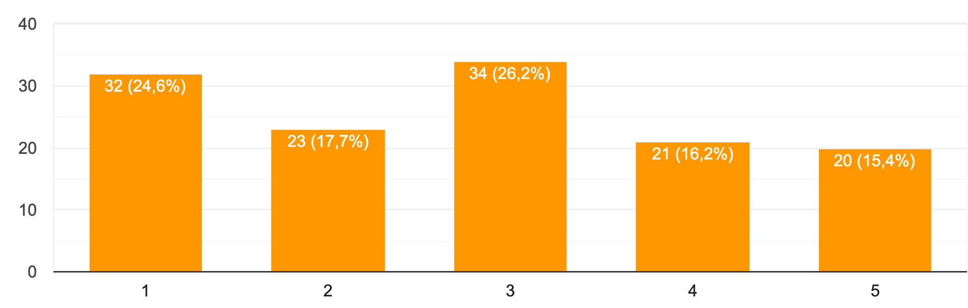
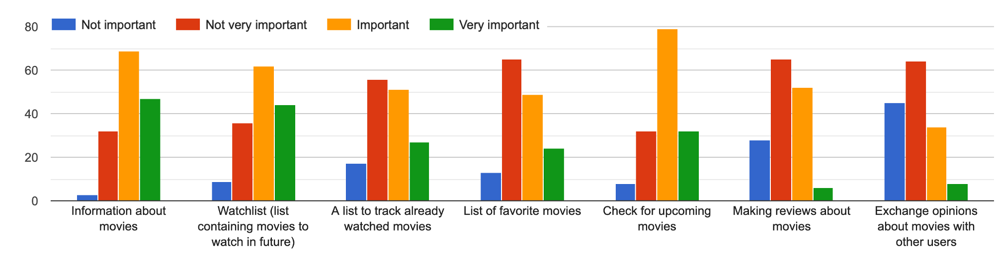
Questionnaire – Part 4
If you don't use any movies related app, how much would you be interest in using one?
How much do you think the following features are important in such an app?

Slide 13
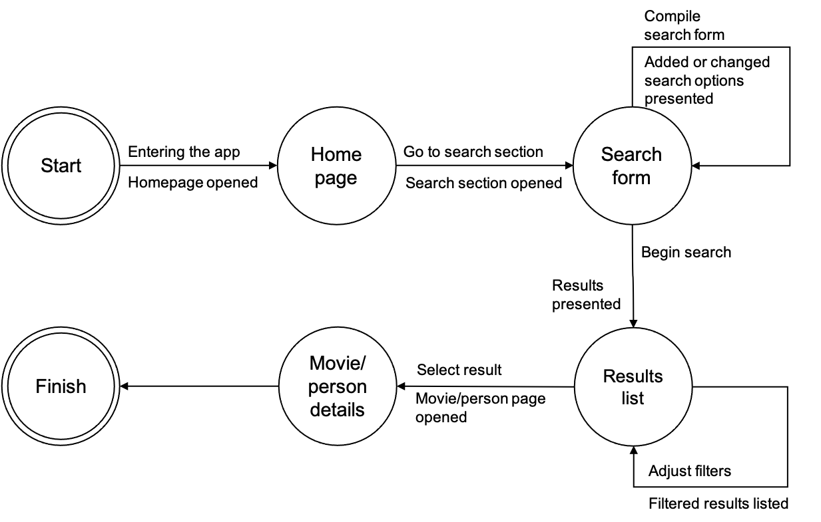
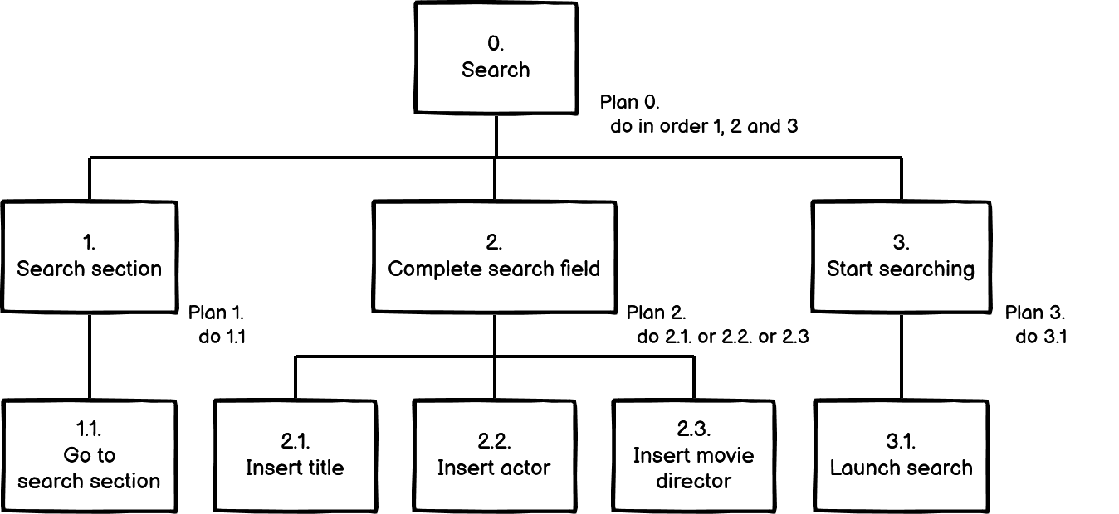
Search for a movie or a person
The user searches for the movie or the person he wants to know information about. He can do search by title, actor or movie director and, when the results are shown, he selects the result he is interested in.
HTA
STN

Slide 14
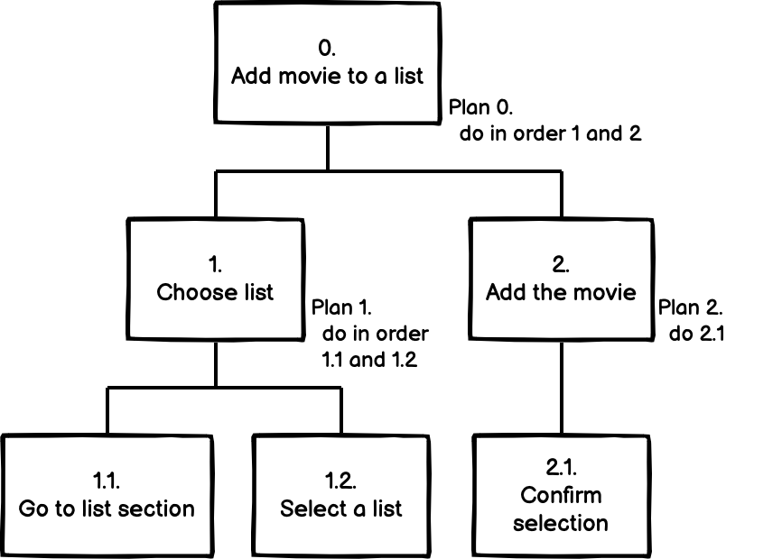
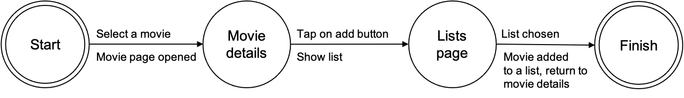
Add movie to a list
The user can add a movie into a list: he can choose between a watchlist that contains movies to watch in the future, a list containing movies already watched and a list containing favourite movies. We are assuming that the user has already selected a movie.
HTA
STN

Slide 15
Search for a movie or a person
The user searches for the movie or the person he wants to know information about. He can do search by title, actor or movie director and, when the results are shown, he selects the result he is interested in.
HTA
STN

Slide 16
Competitors analysis

Slide 17
User profile
Age | 18-50 years
Gender
Profession | Any
Education | Any
Location | Any
Technology | Basic smartphone experience
Passions | Cinema, movies

Slide 18
User profile
Age | 18-50 years
Gender
Profession | Any
Education | Any
Location | Any
Technology | Basic smartphone experience
Passions | Cinema, movies

Slide 19
Competitors analysis
Cinemaniac
+500k downloads
Strengths:
Keep track of seen movies
Possibility to save favourite movies in a list
Statistics about user watch history and preferences
Weaknesses:
Interface not so user friendly
No user interaction
No information about streaming platform
Search about movies not intuitive
In-app purchases to remove advertisements and unlock some functionalities

Slide 20
Competitors analysis
Competitors analysis

Slide 21

Competitors analysis
Cinemaniac
+500k downloads
Strengths:
Keep track of seen movies
Possibility to save favourite movies in a list
Statistics about user watch history and preferences
Weaknesses:
Interface not so user friendly
No user interaction
No information about streaming platform
Search about movies not intuitive
In-app purchases to remove advertisements and unlock some functionalities

